Slide 1

BE Project Phase I Presentation Early Detection of Alzheimer’s Disease Presented by ANIRUDDH KAWLE (BEA29) AAYUSH WALOKAR (BEA20) SHITAL KARDILE (BEA24) Guided by Prof. SHWETA JAIN
Dept. of Electronics and Telecommunication
Hope Foundation’s
International Institute of Information Technology Hinjawadi Pune

Slide 2
Outline
Introduction
Literature survey
Gap Identification
Problem statement and Objectives
Proposed Methodology
Requirement analysis
Impact analysis
Professional Ethical practices to be followed
System Implementation
Results and discussion
Conclusions and Future Scope
References

Slide 3
Introduction
Alzheimer’s Disease (AD) is a progressive neurological disorder causing memory loss, cognitive decline, and behavioral changes, mainly in the elderly. Early detection, especially at the Mild Cognitive Impairment (MCI) stage, is crucial to slow disease progression.
Traditional diagnostic methods using MRI or PET scans are often manual, subjective, and time-consuming. To address this, AI and Deep Learning—particularly Convolutional Neural Networks (CNNs)—offer a powerful alternative for accurate and early diagnosis.
This project uses the ADNI dataset to train a deep learning model that classifies brain scans into Normal, MCI, and AD categories. Model performance will be evaluated using accuracy, precision, recall, F1-score, and ROC-AUC to ensure clinical reliability

Slide 4
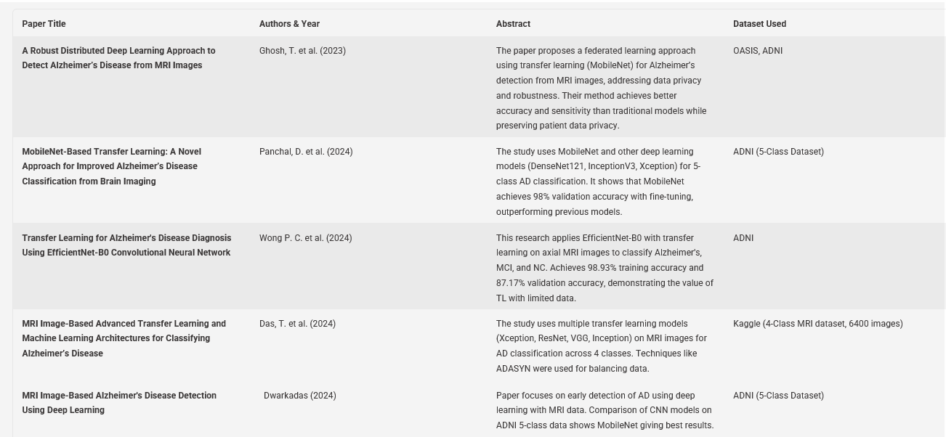
Literature survey

Slide 5
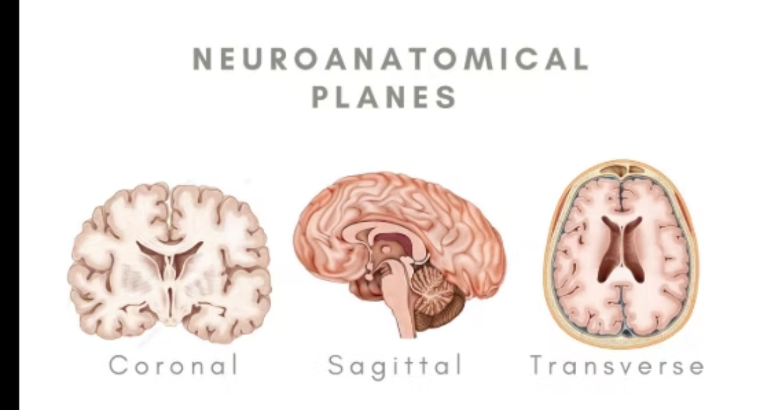
Gap Identification
Ensures that Alzheimer's disease should be detected earlier, it can enhance quality of life and reduce Healthcare costs.
Lack of lightweight , high accuracy(approx. 95%) model for ADD.
Poor performance on Early/Mild cognitive stages
Limited privacy preserving approaches
High Computational cost and lack of real world deployment.
Incompatiability models with both mobile as well as embedded system.

Slide 6
Problem statement and Objectives
Problem statement
Alzheimer's disease (AD) is a chronic neurodegenerative disorder affecting memory, cognitive functions, and behavior, ultimately interfering with daily life. It is the most common cause of dementia worldwide and a significant public health challenge.
Existing machine learning approaches for Alzheimer’s detection face limitations such as dependence on handcrafted feature extraction, lack of automation, and reduced accuracy in identifying early or mild cognitive impairment (MCI) stages. Additionally, small and imbalanced datasets further restrict model performance and generalization.
Objectives
• To develop a MobileNet-based deep learning model capable of detecting Alzheimer’s disease at early stages from brain imaging (e.g., MRI).
• Improve diagnostic accuracy over traditional CNN models like VGG, AlexNet, ResetNet and DenseNet by using MobileNet residual learning.
• Detect early stages such as Mild Cognitive Impairment (MCI) to enable timely intervention and improve patient outcomes.
•Ensure high accuracy, sensitivity, and specificity

Slide 7
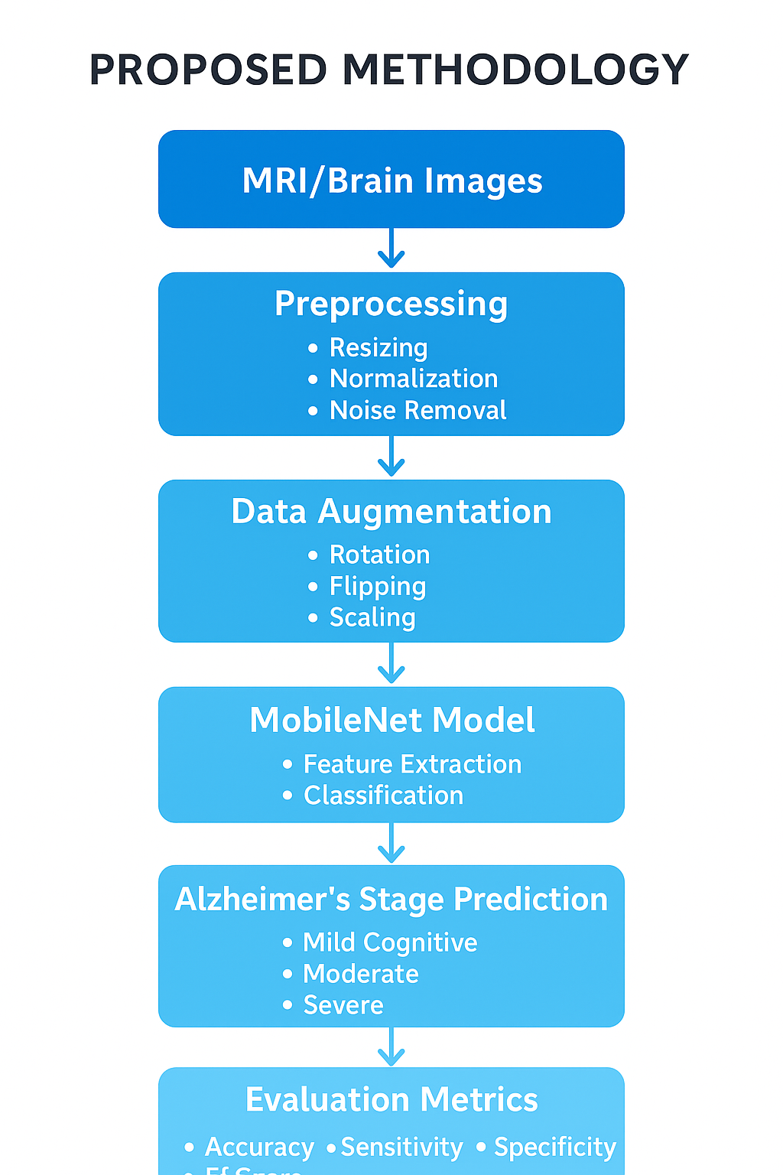
Proposed Methodology

Slide 8
Proposed Requirement analysis
Requirements of Resources Hardware: 9 1 • High-performance GPU (e.g., NVIDIA GTX/RTX series) for deep learning training. • Minimum 16 GB RAM and sufficient storage to handle large datasets.
Software:
Deep learning frameworks: TensorFlow, Keras, or PyTorch for implementing MobileNET.
Data processing libraries: Pandas, NumPy, OpenCV (for image data), Scikit learn.
Visualization tools: Matplotlib, Seaborn, or Plotly for charts and dashboards.
Data:
• Historical datasets from public repositories or industry sources.
• Properly labeled data for effective training and validation of the model.
ADNI Dataset
Platforms / Tools:
• Cloud platforms like Google Colab, AWS, or Azure for scalable computation.
• Version control tools like GitHub for code management

Slide 9
Impact analysis
Positive Impact of Project on Environment:
• Energy Efficiency: By optimizing processes and predicting events early, the system can reduce unnecessary energy consumption.
• Waste Reduction: Accurate detection and prediction can help minimize resource wastage in industrial or operational processes.
• Monitoring Environmental Parameters: If integrated with sensors, the system can track environmental data, contributing to better environmental management.
b. Negative Impact of Project on Environment:
Electronic Waste: Deployment of additional hardware and sensors may contribute to e-waste if not properly managed.
Energy Consumption: High computational requirements for training deep learning models (like MobileNet) can consume significant electricity.
Resource Usage: Large-scale data storage and processing can increase environmental footprint due to server and cooling requirements.

Slide 10
Professional Ethical practices to be followed
Professional Ethics:The project upholds honesty, transparency, and integrity in all phases of design, implementation, and reporting.No manipulation of data, results, or algorithms has been done, and all references, datasets, and tools used are duly acknowledged.The system is designed solely for academic and research purposes, respecting privacy and confidentiality of any medical data used.
Professional Responsibilities:The responsibility of ensuring data privacy and patient confidentiality is strictly followed, in accordance with ethical guidelines for handling biomedical data.The model’s predictions are intended to support medical experts, not replace them, thereby maintaining responsible use of AI in healthcare.The team commits to continuous learning, updating the system based on new technological and ethical standards.
Engineering Norms and Best Practices:Standard software engineering practices are followed, including modular design, documentation, version control, and code reliability testing.Compliance with AI and software development standards such as IEEE and ISO guidelines ensures system robustness and safety.The project emphasizes sustainability, fairness, and accountability, ensuring that the technology benefits society without bias or misuse.

Slide 11
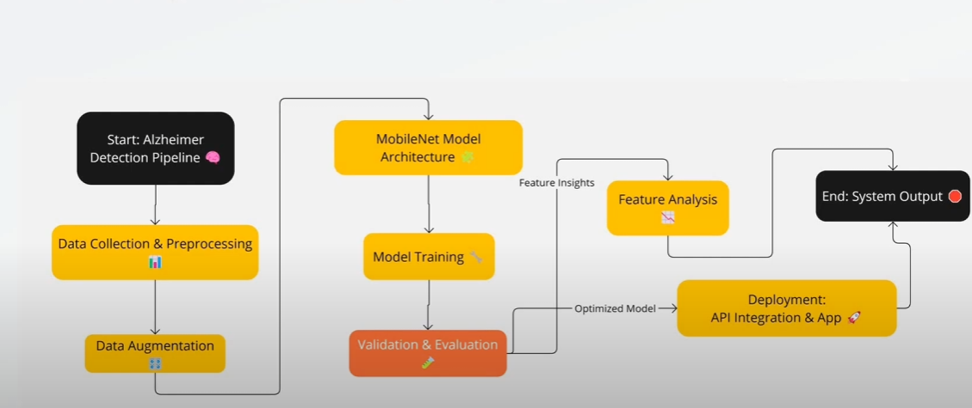
System Implementation

Slide 12
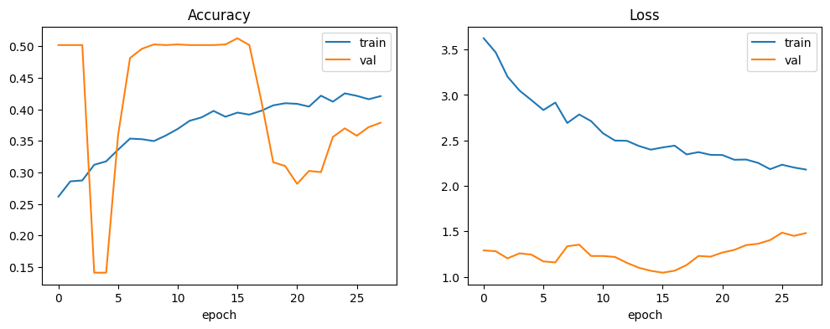
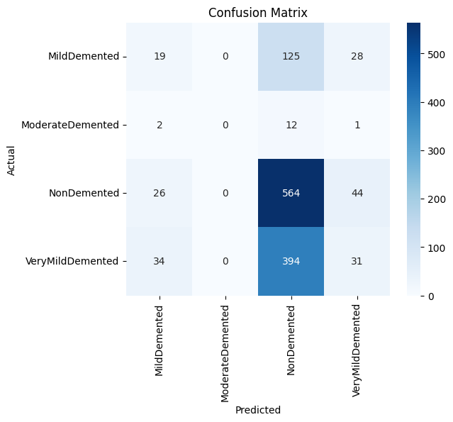
Results and discussion
Training & Validation Accuracy
Training accuracy increases steadily from 0.25 to 0.42, indicating consistent learning.
Validation accuracy rises initially but fluctuates between 0.15–0.50, showing unstable generalization.
The gap and fluctuations suggest overfitting, where the model learns the training data more than unseen data.
2. Training & Validation Loss
Training loss decreases smoothly from 3.6 to 2.2, showing reduced error on the training set.
Validation loss remains lower (~1.0–1.5) but fluctuates and begins rising at later epochs.
This inconsistent pattern again indicates overfitting and reduced model performance after certain epochs.
3. Confusion Matrix Interpretation
The model predicts the NonDemented class well (564 correct), showing a bias toward the majority class.MildDemented, VeryMildDemented, and ModerateDemented show high misclassification.
Many dementia cases get predicted as NonDemented:125 MildDemented → NonDemented394 VeryMildDemented → NonDemented12 ModerateDemented → NonDemented.

Slide 13
Conclusions and Future Scope
Conclusion:
The proposed system for early detection of Alzheimer’s disease using the MobileNet architecture demonstrates that lightweight deep learning models can effectively classify different stages of Alzheimer’s with high accuracy and reduced computational cost. By employing preprocessing and data augmentation techniques, the model was able to enhance image quality, increase dataset variability, and minimize overfitting, resulting in improved prediction performance.
Future Scope :
the proposed system can be further enhanced and expanded in several directions. In the future, the model can be trained on larger and more diverse MRI datasets to improve generalization and clinical reliability. The performance can be optimized further by integrating multi-modal data such as PET scans, cognitive scores, or genetic information to provide more comprehensive diagnostic insights.

Slide 14
References
1.T. Ghosh, M. I. A. Palash, M. A. Yousuf, M. A. Hamid, M. M. Monowar, and M. O. Alassafi,"A Robust Distributed Deep Learning Approach to Detect Alzheimer’s Disease from MRI Images,"Mathematics, vol. 11, no. 12, p. 2633, Jun. 2023, doi: 10.3390/math11122633
2.D. Panchal, N. Kothari, D. Gada, P. Kanani, L. Kurup, D. Sankhe, and G. Pandya,"MobileNet-Based Transfer Learning Novel Approach for Improved Alzheimer’s Disease Classification from Brain Imaging,"International Journal of Intelligent Systems and Applications in Engineering (IJISAE), vol. 12, no. 3, pp. 2777–2783, 2024.
3.P. C. Wong, S. S. Abdullah, M. I. Shapiai, and A. K. M. M. Islam,"Transfer Learning for Alzheimer's Disease Diagnosis Using EfficientNet-B0 Convolutional Neural Network,"Journal of Advanced Research in Applied Sciences and Engineering Technology, vol. 35, no. 1, pp. 181–191, 2024.
4.T. Das, C. K. Nayak, and P. Pattnayak,"MRI Image-Based Advanced Transfer Learning and Machine Learning Architectures for Classifying Alzheimer’s Disease,"Proceedings of the Second International Conference on Intelligent Cyber Physical Systems and Internet of Things (ICoICI 2024), IEEE, 2024
5.D. Panchal et al.,"MobileNet-Based Transfer Learning: A Novel Approach for Improved Alzheimer’s Disease Classification from Brain Imaging,"International Journal of Intelligent Systems and Applications in Engineering, vol. 12, no. 3, pp. 2777–2783, 2024.

